Slide 1
Embedded Systems project

Slide 3
What is Embedded systems and its applications
Embedded systems is a combination of hardware and software.
It can be used in many applications like : smart homes, microwaves , dishwasher , traffic light , …etc.

Slide 4
Traffic Light project
We will discuss :
the component that we will use.
The sequence to perform the task.
The code using mikroC .

Slide 5
the component that we will use
PIC16F877A microcontroller
Crystal(HS 8MHZ)
Resistance
Capacitors
LDS(green , yellow ,red)
7448 IC decoder
NPN transistor
4 SSD CC
3 Buttons

Slide 6
The sequence to perform the task
Hint: the traffic light can be used with automatic mode or with manual mode
HINT:we can use the auto/manual switch to change the state of traffic light from automatic mode to manual mode
When you run the program you will be in the automatic mode , then the first 2SSD will count 23 second for the west street and the red LED in west street will be on and the green LED in the south street will be on and the second 2SSD will count 20 second from 20 to 0 for the south street.
When the second 2SSD reach to 0 , then the green LED in the south street will be off and then the first 2SSD will count 3 second from 3 to 0 and the second 2SSD will count 3 second from 3 to 0 and the yellow LED in south street will on.

Slide 7
The sequence to perform the task
When the 4 SSD reach to 0 , the first 2SSD will count 15 second for the west street , the yellow LED in south street will be off and the red LED in west street will be off and the red LED in south street will be on and the green LED in the west street will be on and the second 2SSD will count 12 second from 12 to 0 for the south street.
When the second 2SSD reach to 0 , then the green LED in the west street will be off and the then the first 2SSD will count 3 second from 3 to 0 and the second 2SSD will count 3 second from 3 to 0 and the yellow LED in west street will on.
When the 4 SSD reach to 0 , the yellow LED in west street will off and the red LED in south street will be off
Then the code for automatic mode will be repeated if you don’t clik on auto/manual switch

Slide 8
The sequence to perform the task
if you clik on auto/manual switch , the traffic light will be in manual mode .
when you clik on manual switch , then the green LED in south street will be on and the red LED in west street will be on.
then if you click on manual switch the green LED in south street will be off and the yellow LED in south street will be on for 3second and the 2SSD for south street will count from 3 to 0
then the yellow LED in south street will be off and the red LED in west street will be off and the red LED in south street will be on and the green LED in west street will be on.

Slide 9
The sequence to perform the task
then if you click on manual switch , the green LED in west street will be off and the yellow LED in west street will be on for 3second and the 2SSD for west street will count from 3 to 0.
then the yellow LED in west street will be off and the red LED in south street will be off and the red LED in west street will be on and the green LED in south street will be on .
the manual mode will be executed like what we discussed in brevious slide.

Slide 10
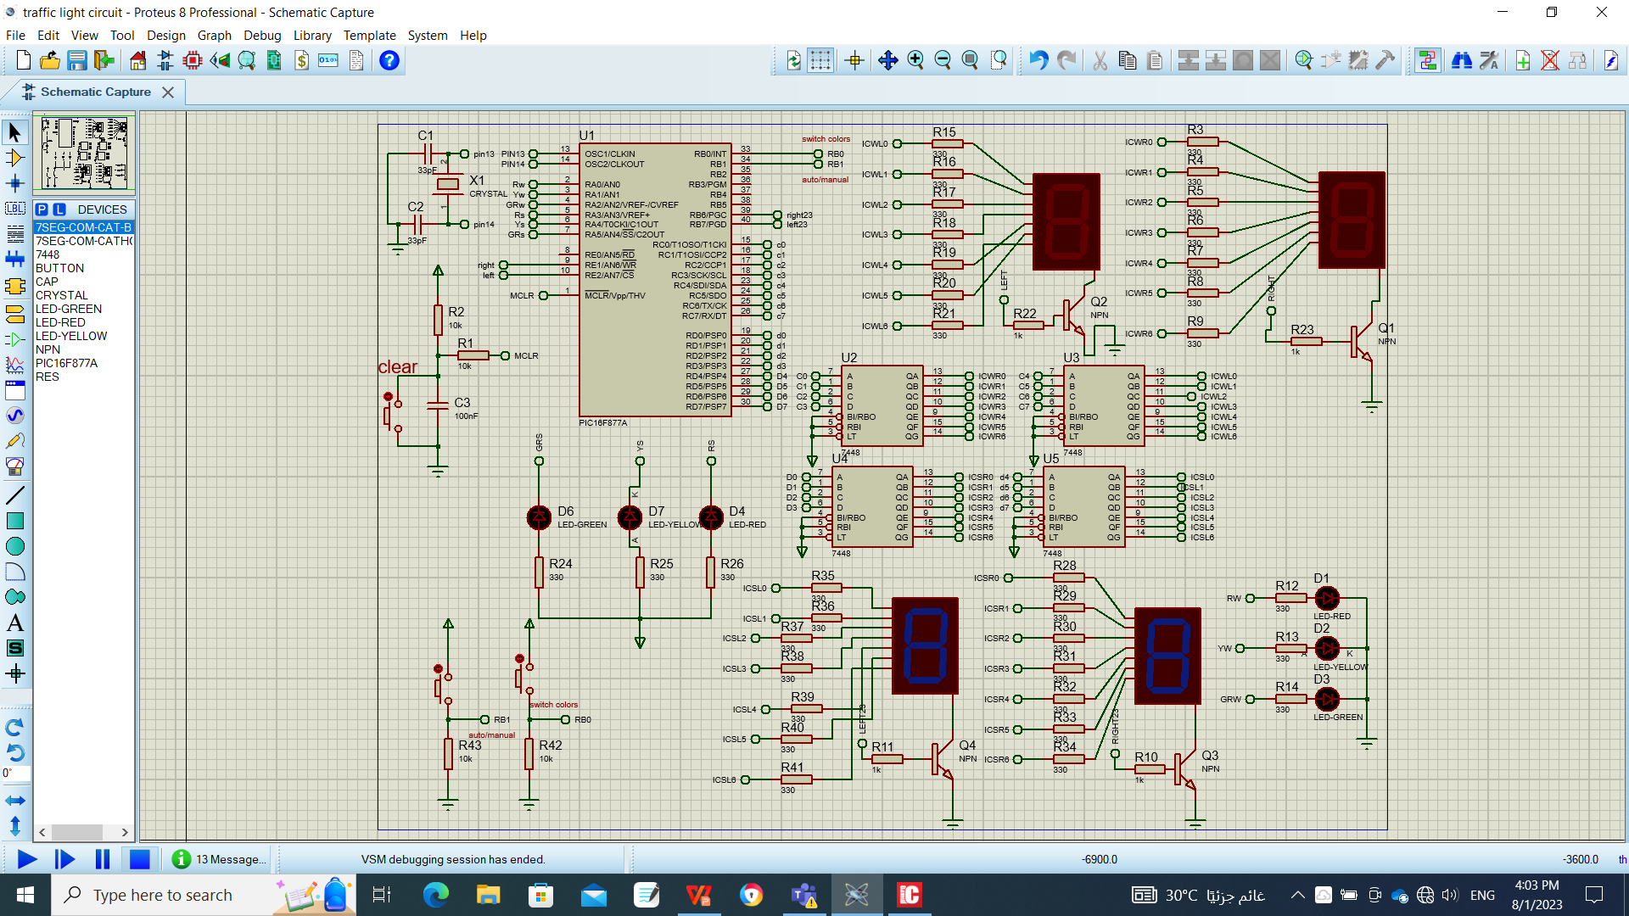
THE circuit design on protoues

Slide 11
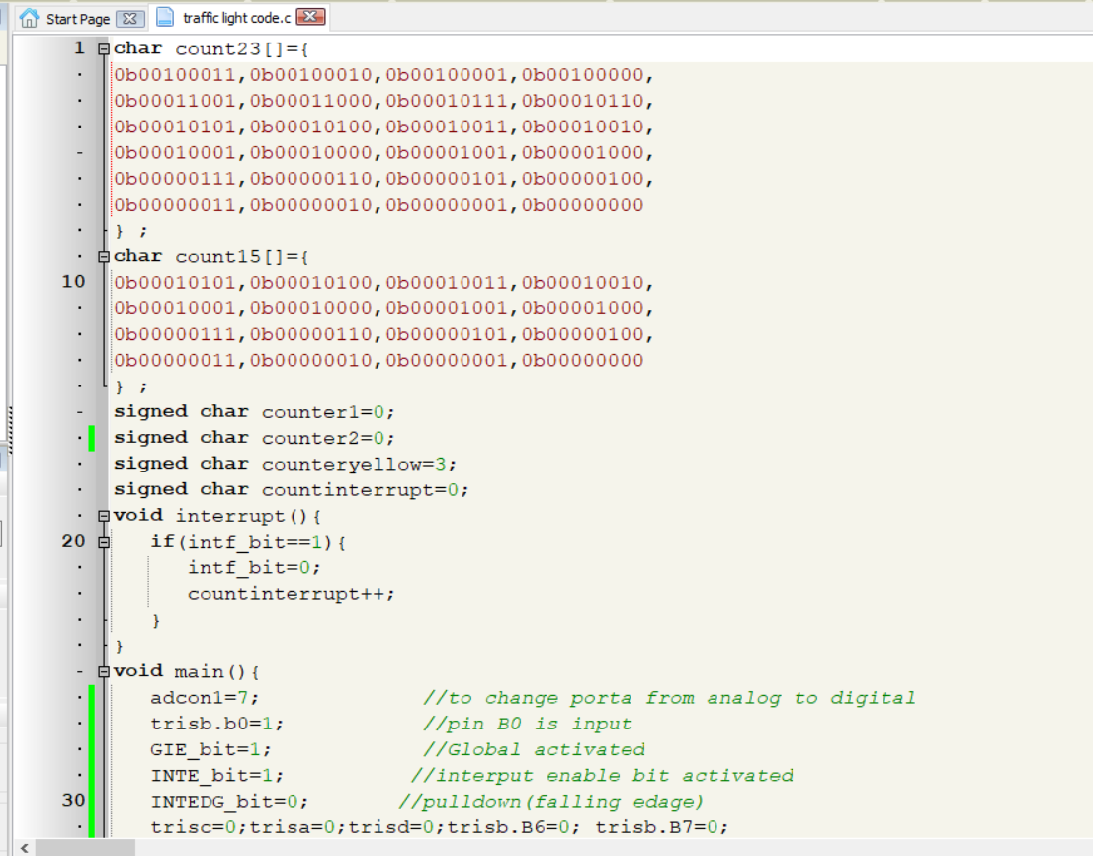
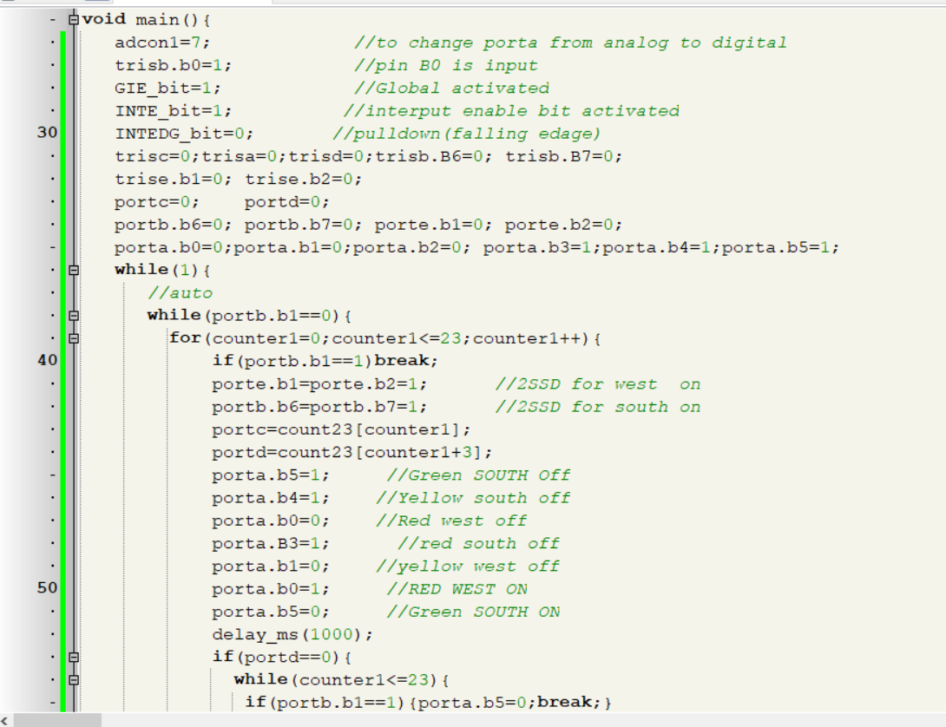
the code on mikro-c

Slide 12
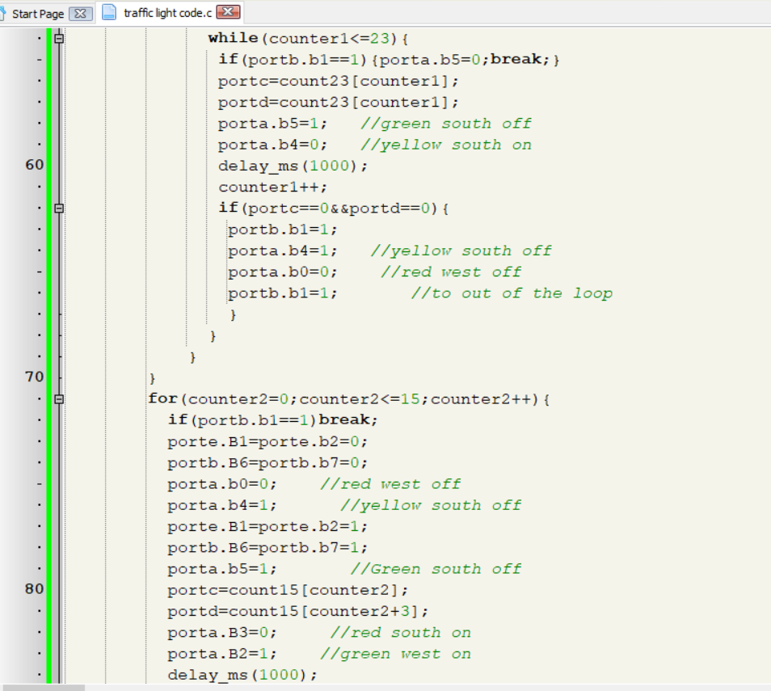
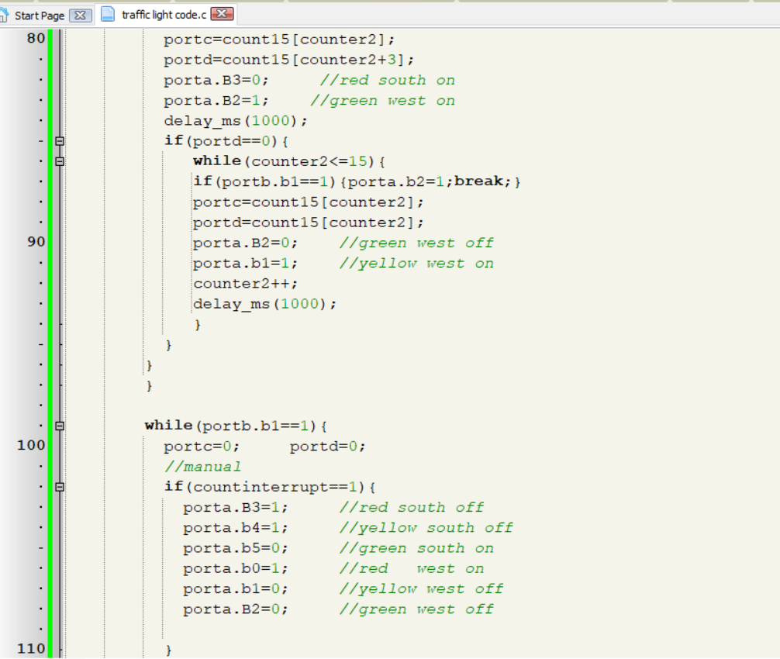
the code on mikro-c

Slide 13
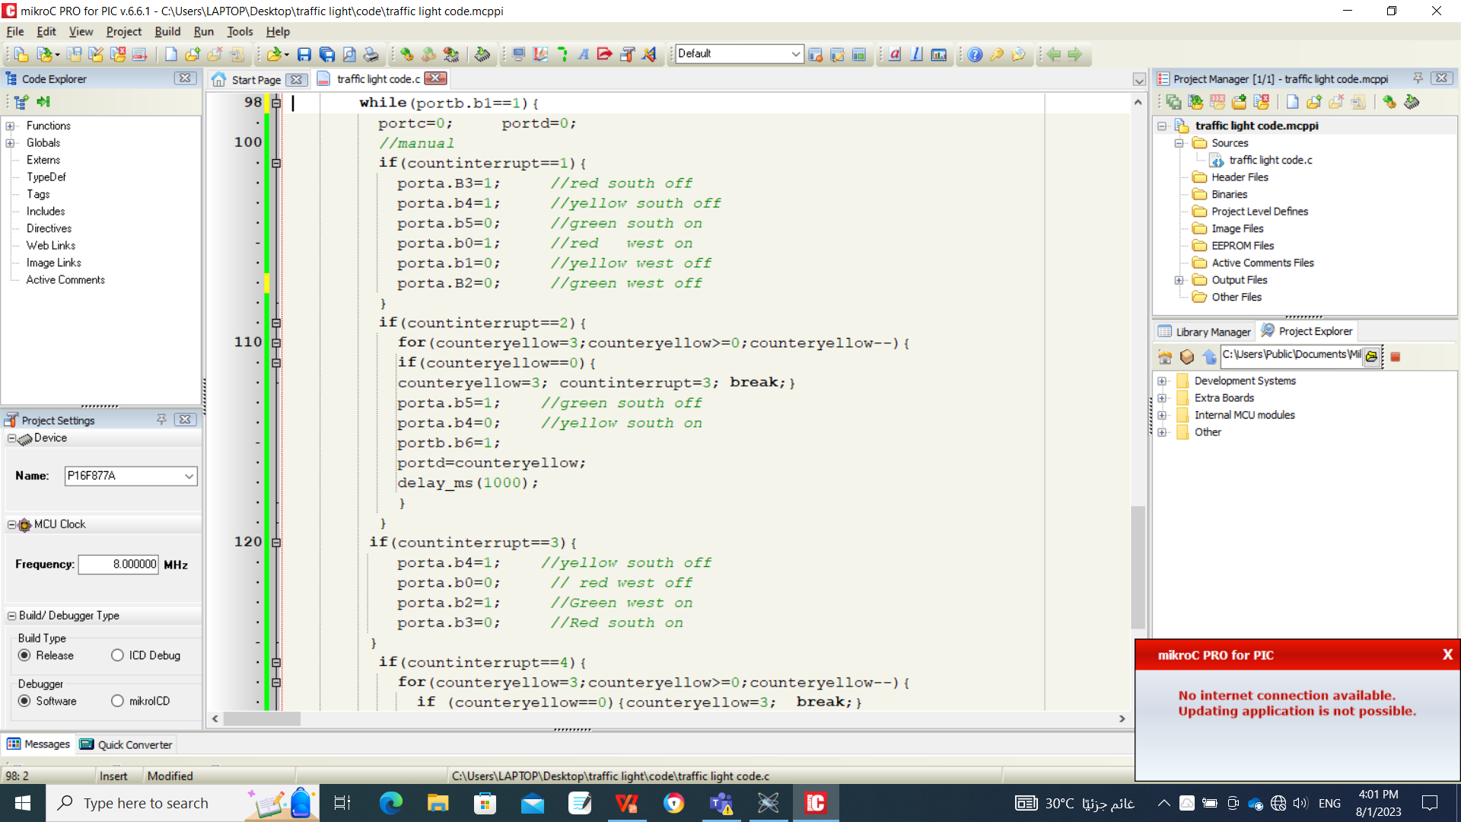

the code on mikro-c

Slide 14
THANK YOU

